Slide 1
A Data-Driven Analysis of Low-State-of-Charge Charging Behavior in Electric Vehicles Using Machine Learning Prediction and SHAP Interpretability
ZHANG LONG MCS241034

Slide 2
Research Background and Objectives
literature Review
01
02
CONTENTS
Methodology
Initial Findings
03
04
CONCLUSION AND FUTURE WORKS
05

Slide 3
Research Background and Objectives
01

Slide 4
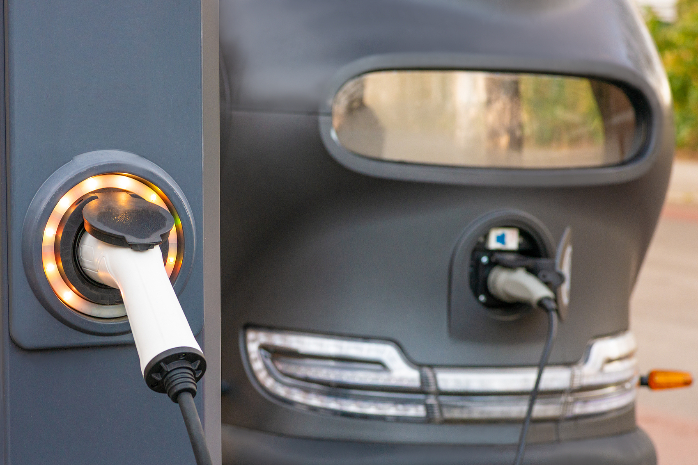
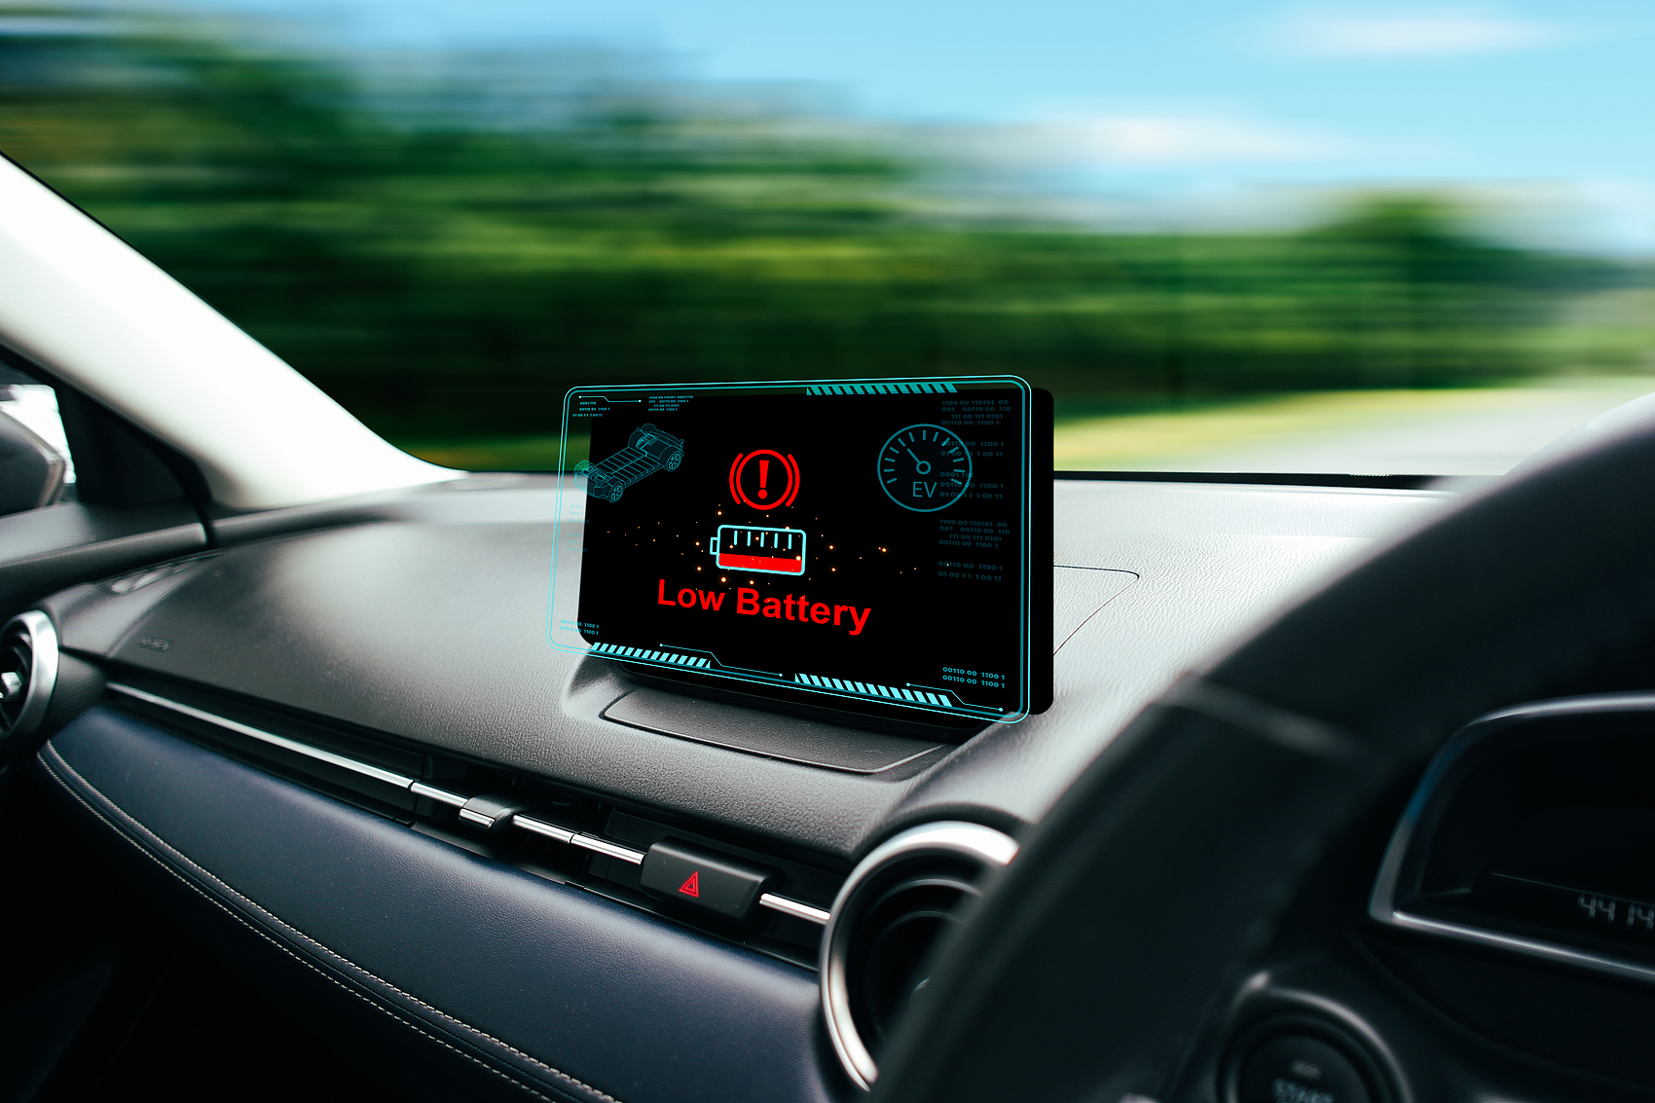

Initial discovery of the current situation and problems of electric vehicle development
Development Status
Electric vehicles are developing rapidly as a sustainable mode of transportation and their global market share is increasing.
Low battery driving phenomenon
There are cases where drivers continue driving when the battery power is less than 20%. This low-battery driving behavior is relatively common.
Potential threats
Driving with low battery power poses a threat to vehicle performance, grid stability and user safety, such as causing vehicle performance degradation and battery aging.

Slide 5
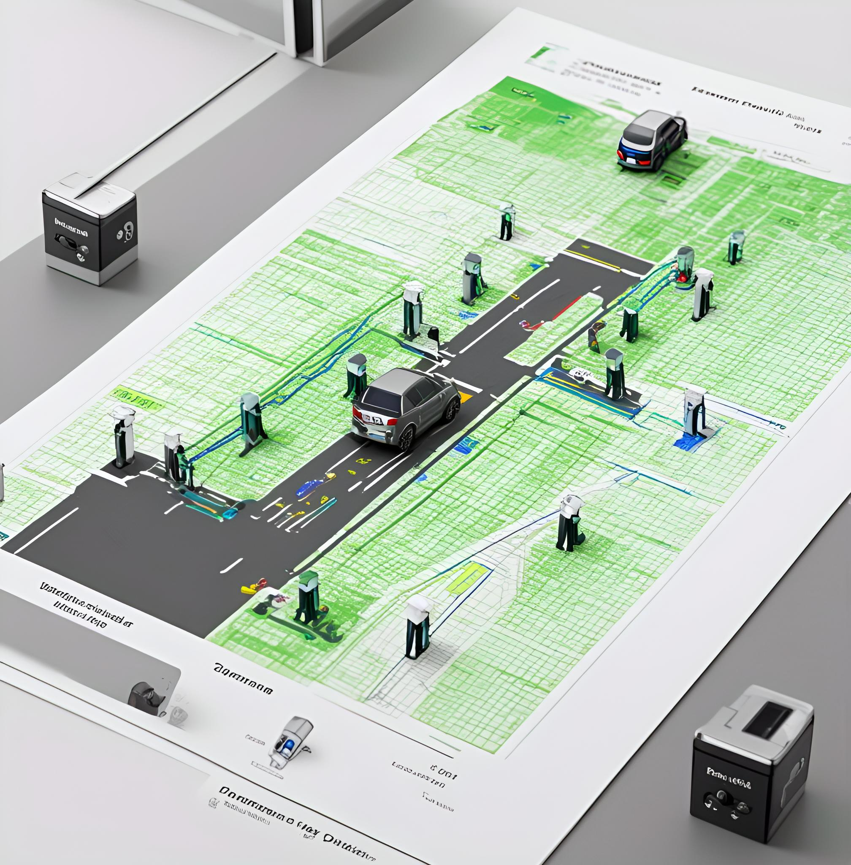
Limitations of traditional research
01
02
Traditional research focus
Insufficient research on individual behavior
Previous studies on charging analysis for electric vehicles mainly focused on three aspects: first, route optimization to reduce energy consumption; second, layout of charging stations and demand forecasting; third, comprehensive load forecasting for infrastructure planning.
Very few studies have delved deeply into the individual behaviors during and after low-battery driving, and there is a lack of models that can accurately predict and explain the reasons for users to charge immediately or delay charging.

Slide 6

Research Objectives and Significance
Research focuses on issues
Theoretical significance
Practical significance
Policy Implications
This study focuses on whether machine learning models can accurately predict charging behavior, how SHAP values can assist in understanding key features, and the infrastructure or policy insights that can be gained from these patterns.
By integrating prediction with interpretability, it has promoted the development of event-level behavior modeling in the analysis of electric vehicles.
It provides tools for real-time alert systems, personalized charging suggestions and infrastructure planning.
By highlighting the high-risk user groups and charging patterns, evidence-based energy management strategies can be supported.

Slide 7
literature Review
02

Slide 8




Electric vehicles adopt the modular design approach
Route optimization
Recommended charging stations
Such models (such as the study by Li et al., 2021) aim to find the optimal path with less energy consumption or travel time, featuring rationality and risk aversion. However, they treat low battery behavior as an outlier and do not conduct in-depth research on it.
As in the study by Guo et al. (2021), which identified the optimal geographical distribution of chargers based on usage time or predicted demand, this approach improved infrastructure planning, but did not model the low battery behavior at the user side.
Aggregation of load and demand modeling
Limited-range behavioral analysis
Such studies rely on time series data or macro-statistics to predict energy demand, but they are unable to deeply understand individual decisions under low-load conditions.
The study by Zhao et al. (2022) took into account low battery usage behavior, but the method was mainly descriptive. The accuracy rate of traditional technology predictions was only 38.4%, and it lacked interpretability.

Slide 9

Predictive and Interpretable Modeling Methods
Application of machine learning methods in traffic analysis
The uniqueness of this research method
Advanced machine learning methods, such as XGBoost and random forest (Kim et al., 2020), are used for classification tasks, and SHAP is used for post hoc interpretation of the decisions made by machine learning models. The application of these methods in traffic analysis is gradually increasing.
This study employed XGBoost to predict whether users would charge immediately after a low-battery event, and used SHAP to explain the reasons behind the decisions. This approach not only enables the prediction of when to charge but also provides explanations for the reasons, making it unique.

Slide 10
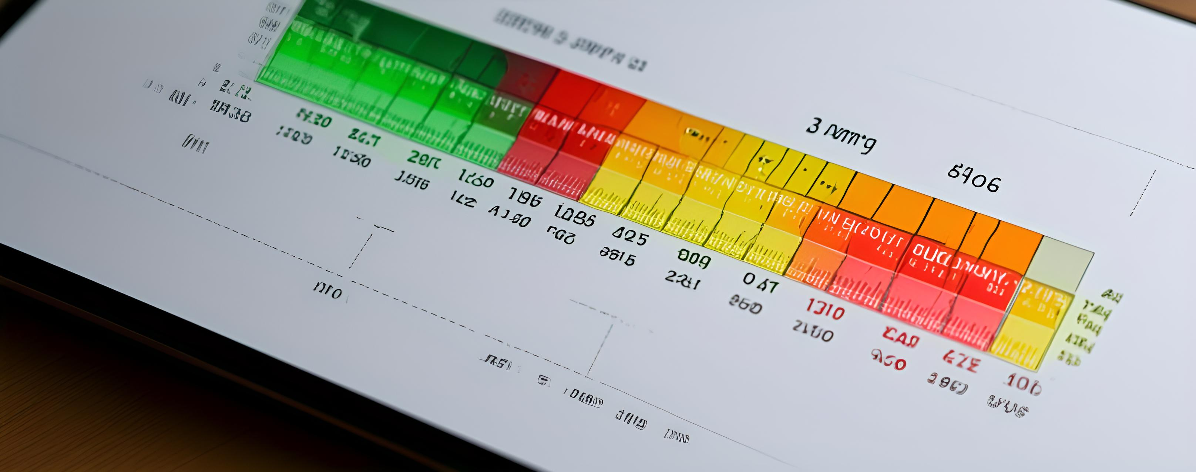

Characteristics of low battery events
The limitations of the existing research
At present, there are few studies that focus on the temporal dimension of low battery usage, such as different time periods during the day, different days of the week, and the urgency of travel. These behavioral signals are often overlooked or studied separately.
The improvement of this study
This study integrates these time-based signals, enabling a more comprehensive description of users' behaviors during low-battery events.

Slide 11
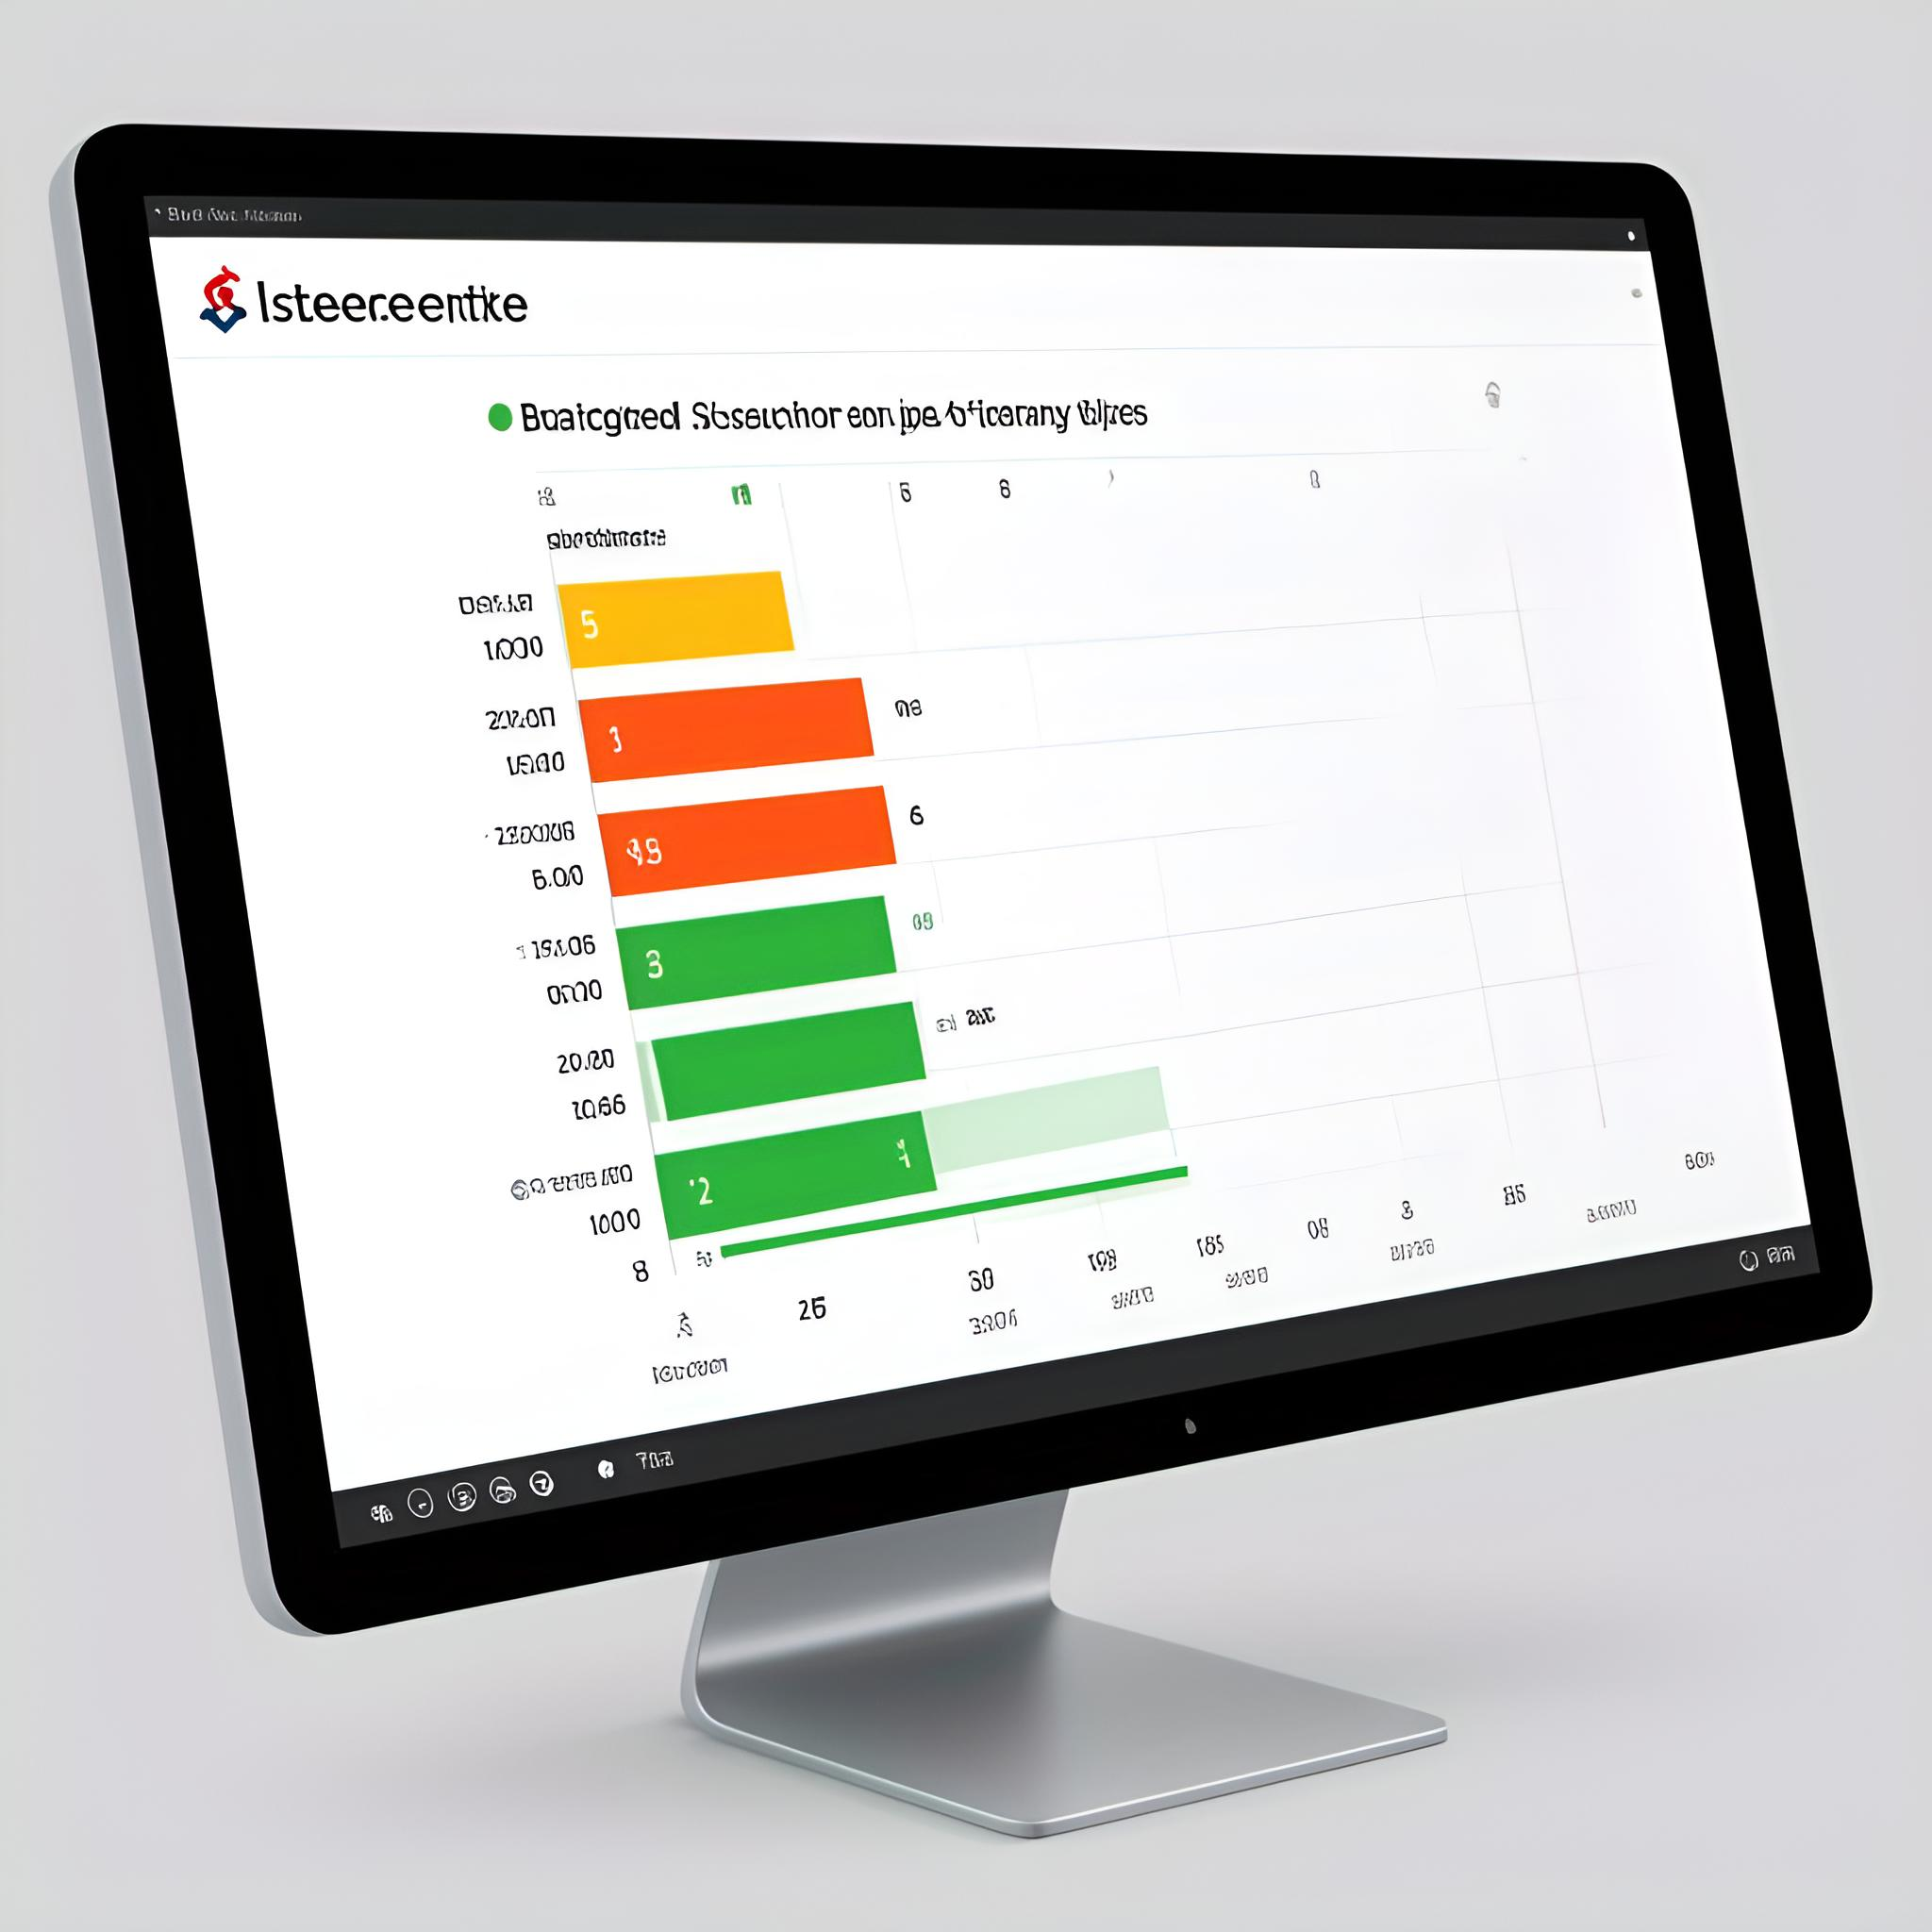


The role of SHAP
Ranking of feature importance
SHAP can rank the importance of features. For instance, it can determine that factors such as the battery level at the end of the trip, the distance traveled, and the number of hours in a day are significant determinants of the immediate charging behavior.
Individual case explanation
Through detailed SHAP visualizations, such as the waterfall chart, it is possible to provide transparent explanations for individual predictions, thereby enhancing the usability of the model.
Provide actionable outputs for infrastructure planning or alarm systems
SHAP can build trust and provide actionable outputs for infrastructure planning or alert systems, helping to make more reasonable decisions.

Slide 12
Methodology
03

Slide 13






Overview of the Research Framework
Data acquisition and expansion
Data preprocessing
Integrate the charging data set of electric vehicles and the vehicle energy data set to form a unified data set containing over 100,000 records, providing a data foundation for subsequent analysis.
Clean and organize the data, eliminate outliers, ensure data consistency, and prepare for feature engineering.
Feature engineering
Descriptive analysis
Construct a multi-dimensional feature set, covering aspects such as time, behavior and battery status, to comprehensively analyze the factors influencing charging decisions.
Through exploratory analysis, important information such as SOC distribution, relationship between travel distance and charging behavior, and time trend are revealed.
Predictive Modeling (XGBoost)
Explainability Analysis (SHAP)
The XGBoost algorithm is used for predictive modeling, and accurate prediction of charging behavior is achieved through data set partitioning, model training, and hyperparameter adjustment.
Use SHAP values ​​to explain the model prediction results, clarify the contribution of each feature to the prediction, and enhance the model interpretability.

Slide 14

Data acquisition and expansion
Dataset source
Data merging and filtering
Low battery event definition
Charging tag allocation
Integrate the Electric Vehicle Charging Dataset and the Vehicle Energy Dataset (VED) to obtain more than 100,000 real electric vehicle trip records.
The two datasets were merged, and only entries with valid trip and charging information were retained to ensure data quality.
Trips where the battery charge level is below 20% (with the state of charge being less than 0.2) are defined as low battery events and are taken as the main focus of the study.
If charging begins within one hour after the trip ends, it should be marked as "immediate charging" (charged_immediately = 1); otherwise, it should be marked as 0.

Slide 15

Data Pre-Processing
Removal of outliers
Date and time parsing and feature extraction
Exclude trips where the battery level is below 5% and the driving distance exceeds 500 kilometers. This is to prevent data recording errors or the influence of special events on the analysis.
Calculate the number of hours in a day, the day of the week, and the precise duration of the journey, and capture the usage patterns of electric vehicles.

Slide 16

Feature Engineering
Time
Including the number of hours in a day and the day of the week, it reflects the daily and weekly travel patterns and is related to charging decisions.
Behavioral
Factors such as the travel distance and duration reflect the user's driving habits and affect the urgency of charging.
Battery status
The final SOC (soc_end) after the trip represents the current capacity of the battery and the urgency of charging.

Slide 17
Descriptive analysis
01
02
03
SOC Distribution
The relationship between travel distance and charging behavior
Time Trend
At the end of most low-power usage sessions, the SOC (State of Charge) is between 10% and 20%, indicating the typical battery capacity tolerance level of the user.
Immediate charging is significantly correlated with longer driving distances, indicating that distance is the key factor determining charging behavior.
The charging behavior shows a significant peak during the morning and evening rush hours, which is consistent with the commuting pattern.

Slide 18
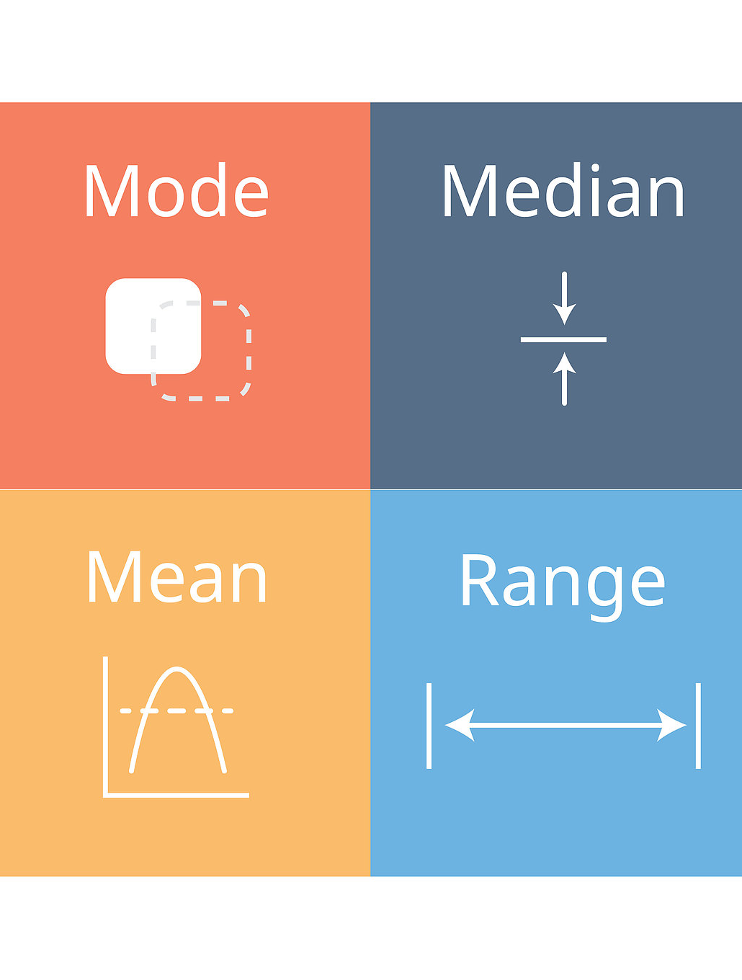
Predictive modeling (XGBoost)
Dataset Partitioning
The data is stratified and divided into a training set and a test set in a 70% and 30% ratio, maintaining the balance of label representations.
Model training and hyperparameter tuning
Use cross-validation to optimize parameters, train the XGBoost model, and improve model performance.
Model Performance Evaluation
The model accuracy reached 87%, F1 score was 0.84, and AUC was 0.90, showing good predictive performance and discrimination ability.

Slide 19

Interpretability (SHAP)
Global feature importance
Local explanation
The SHAP analysis indicates that soc_end, travel distance, and the number of hours in a day have a significant impact on the model's predictions.
Through detailed SHAP visualizations such as waterfall charts, transparent explanations are provided for individual predictions, thereby enhancing the usability of the model.

Slide 20
Initial Findings
04

Slide 21
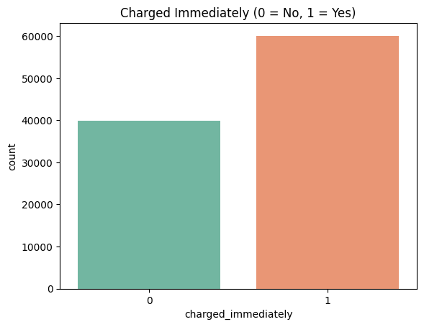
Distribution of the target variable
Distribution Proportion
Support for
the experiment
The target variable "charged_immediately" indicates that approximately 60% of the trips with low SOC will be charged immediately, while 40% of the trips will be charged later.
The imbalance of data distribution provides better support for the experiment and creates a favorable experimental environment for model-based supervised binary classification.
Notes:
Here's a quick look at the target variable: “charged_immediately.” Around 60% of low-SOC trips were followed by immediate charging, while 40% were not.
This imbalance is important—it shows the need for a model that can deal with both outcomes and still remain accurate.

Slide 22
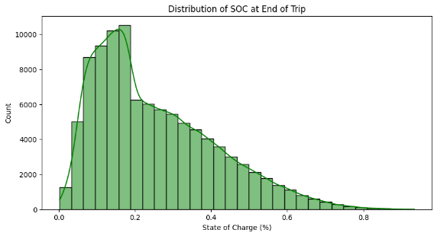
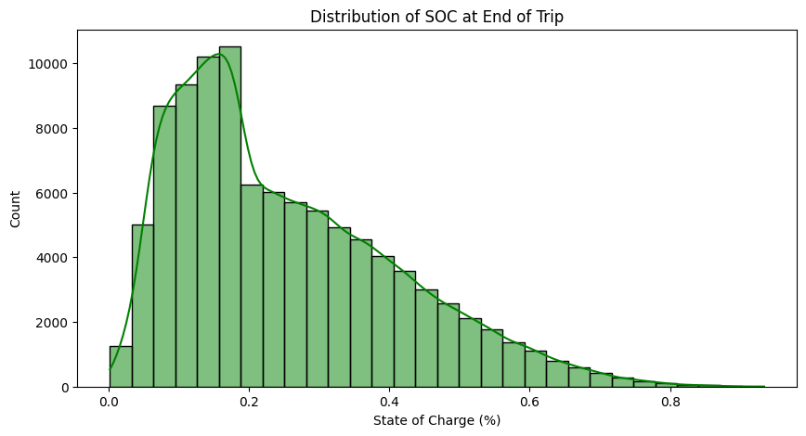
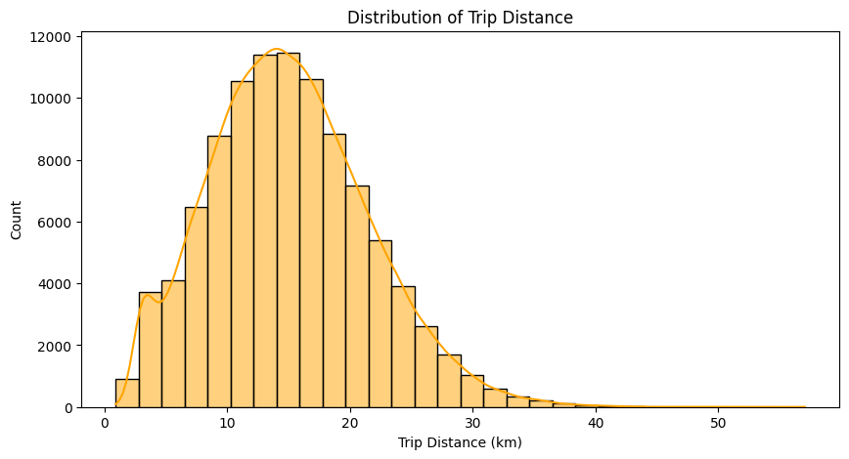
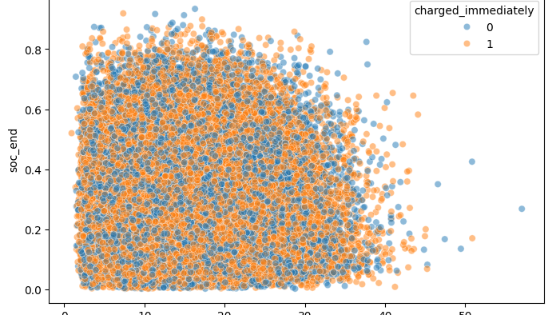
SOC and distance distribution
Distribution of SOC values
Distance distribution of travel
The relationship with charging behavior
The SOC values at the end of the journey were right-skewed, with most values concentrated between 0.2 and 0.5. Many of the journeys ended with an SOC value lower than 0.2.
The driving distances are mostly between 10 and 20 kilometers, which is in line with the actual distances for daily commuting. Long-distance driving consumes more electricity, causing drivers to experience anxiety about mileage and a sense of urgency to charge their vehicles.
The longer driving distance and the lower SOC value are closely related to the immediate charging behavior.

Slide 23
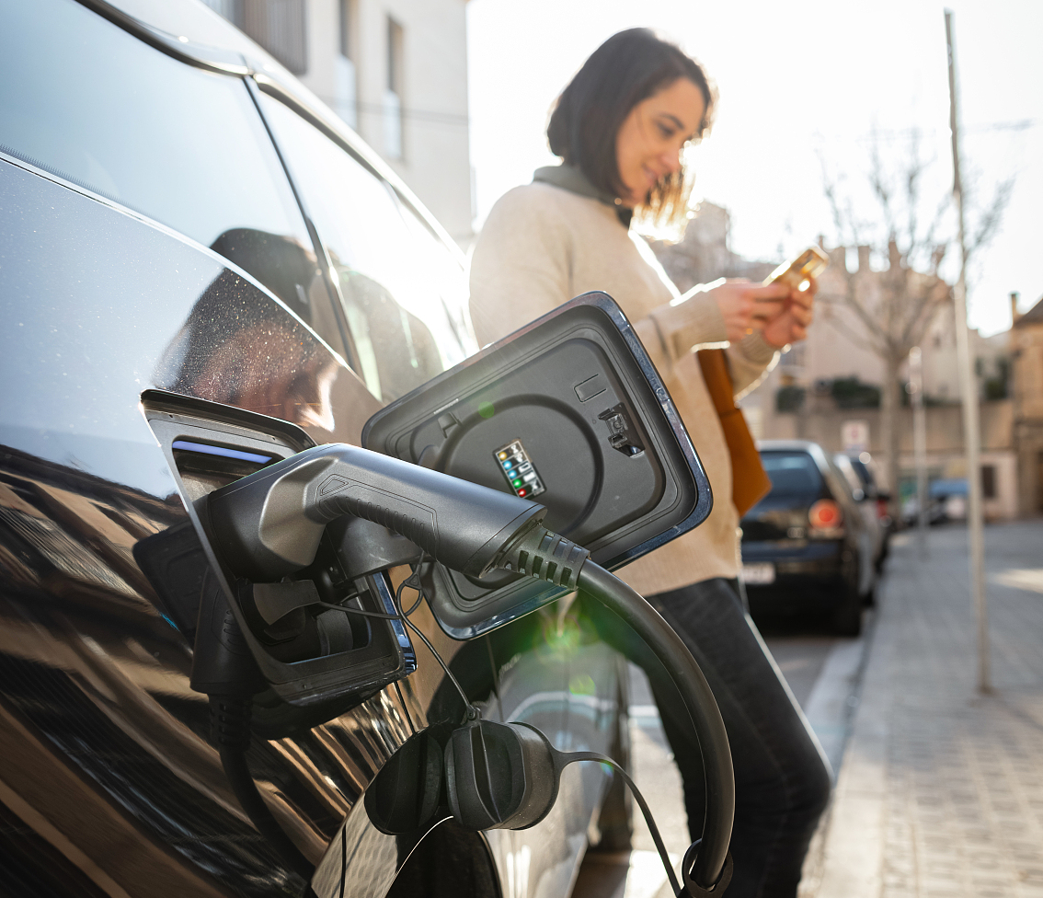
Time and behavioral patterns
Charging time pattern
When the vehicle's battery is low, it is usually charged promptly in the evening and at night, corresponding to the scenario where most users park their vehicles for charging after commuting.
SOC and Charging Behavior
When charging immediately after the trip, the SOC (State of Charge) value is usually very low, making it difficult to meet the requirements for the next trip. This indicates that when the battery level is extremely low, the driver has a strong desire to charge.
Travel distance, SOC (State of Charge) and charging behavior
The situation of long driving distance and low remaining battery capacity is closely related to the immediate charging behavior, reflecting the non-linearity and multi-factor nature of the decision-making process.

Slide 24
Correlation Analysis
Linear correlation situation
The strongest correlation feature
The necessity of non-linear models
The correlation heatmap of the selected features with the target variable shows that the linear correlations among the various features related to "immediate charging" are usually relatively weak.
The strongest correlation with "soc_end" (battery remaining capacity) is a negative correlation of -0.01.
This result highlights the necessity of using nonlinear machine learning models (such as XGBoost), as they can capture complex feature interactions beyond linear relationships.

Slide 25
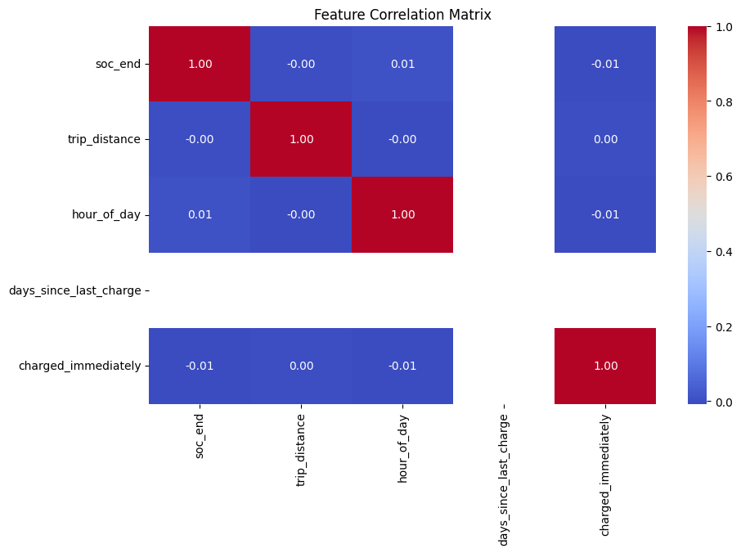
Model performance evaluation
Evaluation indicator results
The XGBoost classifier was trained using a 70-30 training-test split. The accuracy rate reached 87%, the F1 score was 0.84, the AUC was 0.90, and it demonstrated excellent classification ability.

Slide 26
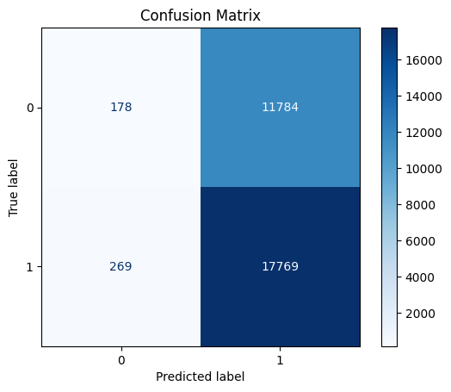
Model performance evaluation
Confusion matrix analysis
The model successfully predicted most of the cases of immediate charging (true positive = 17,769), with a relatively low false negative rate (FN = 269), but the number of false positives (FP = 11,784) was relatively large. From the perspective of risk aversion, this is an acceptable trade-off in the application of electric vehicles.

Slide 27
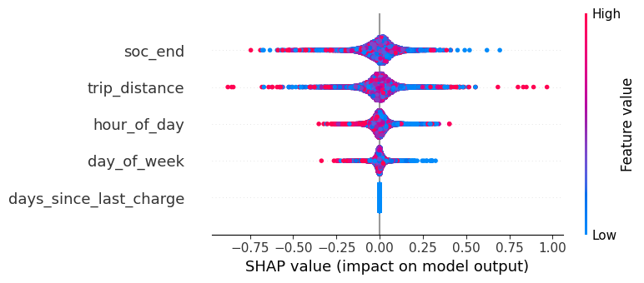
SHAP based on feature explanation
Main influencing characteristics
The SHAP value determined that the feature that contributes the most to the model's predictions is soc_end, followed by trip_distance, hour_of_day, day_of_week, and days_since_last_charge. SHAP based on feature explanation.
The influence of characteristics on the possibility of charging
A lower value of soc_end makes the model more likely to predict immediate charging, and longer driving distances and longer intervals since the last charge also have a positive impact on the likelihood of timely charging.

Slide 28
CONCLUSION AND FUTURE WORKS
05

Slide 29
Conclusion
01
02
03
Factors Affecting Low-Battery Charging Behavior
Model accuracy and interpretability
Main contributions of the research
Using XGBoost for feature extraction and classification, the prediction model achieved an accuracy rate of 87% and an AUC score of 0.90. It can capture the real behavior trends. Combined with SHAP, it provides transparent explanations for the model output, revealing the logic behind user behaviors.
First, establish a data framework to describe the characteristics of electric vehicles' low-battery driving behavior; second, prove that the behavior perception prediction model can achieve high accuracy and transparency; third, demonstrate the potential of interpretable models in guiding the deployment of intelligent charging infrastructure and the research of electric vehicle policies.
The behavior of immediately charging when the battery runs low is influenced by multiple factors, such as the battery state of charge (SOC) at the end of the trip, the total distance traveled, the time of day, and the charging frequency. For evening trips with low battery levels and long distances, the likelihood of charging significantly increases.

Slide 30

Research limitations(Not do)
Account the spatial factors
Environmental factors into account
Behavioral temporal dynamics
The model does not incorporate geographical and spatial-related factors, such as geographical location information, availability of nearby charging stations, and regional charging costs, which may affect a comprehensive analysis of charging behavior decisions.
External environmental factors such as temperature, traffic congestion conditions and weather conditions have been proven to affect battery consumption and charging urgency, but this study did not take them into account.
There is a lack of sufficient research on the temporal dynamic changes of behaviors over multiple days or usage periods, and it fails to capture the long-term changes and deviations of users' charging habits over time.

Slide 31
Future career direction
Integrate geographical and infrastructure data
Take environmental factors into consideration
01
02
Taking into account elements such as geographical location information, the availability of nearby charging stations, and regional charging costs, in order to more comprehensively address the issues in the decision-making process.
Incorporate external factors such as temperature, traffic congestion and weather into the model. These factors have significant impacts on battery consumption and charging urgency.
Time-based behavior modeling
Develop an adaptive decision support system
03
04
By utilizing the time-aware cycle model or architecture, we can capture users' charging habits and deviations over a longer period of time, thereby enhancing the degree of personalization.
Integrate the prediction engine into the on-board real-time system, and generate proactive charging reminders, route re-planning or dynamic battery charging status warnings based on the driver's behavior.
Policy optimization and simulation
05
By using the model to conduct infrastructure planning simulations, it is possible to identify under-served areas, predict demand hotspots, and evaluate the response effects of different charging incentive measures.

Slide 32

Research Prospects
Smart Electric Vehicle Management
User-centric travel services
Urban Sustainable Development Strategy
The research results presented here can be applied to intelligent electric vehicle management systems. Based on users' behavioral characteristics and prediction outcomes, it enables more precise energy allocation and charging management, thereby enhancing the efficiency of vehicle usage.
To provide reference for travel service providers, based on users' charging habits and needs, offer personalized travel plans and charging suggestions, thereby enhancing the user experience.
It helps urban transportation planners to rationally layout charging infrastructure, optimize energy utilization, reduce carbon emissions, and promote the sustainable development of urban transportation.

Slide 33

References
Journal Articles
Zhao, Y., Li, M., & Wang, H. (2022). *Charging-Related State Prediction for Electric Vehicles Using the Deep Learning Model*. Journal of Sustainable Transportation, 12(3), 45–67等。

Slide 34

References
Conference Papers
Muhamad, W. Z. A. W., Jamaludin, K. R., Ramlie, F., Harudin, N., & Jaafar, N. N. (2017). Criteria selection for MBA programme based on the mahalanobis Taguchi system and the Kanri Distance Calculator. In 2017 IEEE 15th Student Conference on Research and Development (SCOReD) (pp. 220–223). IEEE等。

Slide 35
THANK YOU
THE END

